Slide 1
Student Led Conferences
ed-d 407 fall 19
anne, eliza, jamie, and keiro

Slide 2
What are they?
Conferences led by the students themselves.
Parents come to conferences to learn about their child’s progress.
Different centres. Students tell and showcase to their parents what they have been learning
Notes:
SLPCs often replace typical parent-teacher conferences that do not offer a role for the student in the discussion of their learning (Hayden, 1998).

Slide 3
Rationale

Slide 4
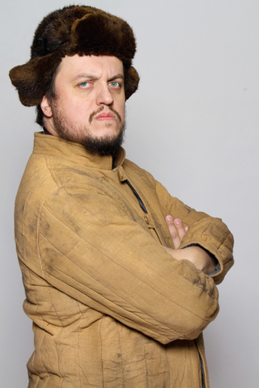
Rationale
Beneficial for everyone
Parents learn about their child’s class programs and teaching methods in the students’ own words.
Students become aware of their own learning, and build valuable communication skills as they explain activities to their parents.
Help the teacher understand their student’s life and their needs.
RUSSIAN AL DECLARES:
Notes:
Opportunity for students voices to be heard.
Teacher gets to see what family expectations, interests, and relationships are.

Slide 5
Rationale
At each station, it is important to include a description of the activity and suggested questions for the parent to ask the student about.
It's a good idea to have a snack and refreshments for at the end of the conference.
RUSSIAN AL EXCLAIMS:

Slide 6
Rationale
Relevant and useful for all subjects and areas of school
Reading, Writing, Math, Science, Social Studies, PE, Music, Art, and Social/Emotional development.
RUSSIAN AL SHOUTS:

Slide 7
Subject Examples of Activity
1 Week prior; students select 2 books to show parents what they can read.
Younger grades choose simple picture books. Older students can read a few select paragraphs from a chapter book.
Questions: “What can you read now that you couldn't read before?” to discuss with parent.
Include choice challenging words students can read to parents
Share writing folders.
Questions: “What have you learned? What skills are you working on? What do you like to write about?”
3 types of hands on math exercises for student to show parent
Kindergarten: Animals graph. Place the animals on the graph table, each in its own column. How many sheep? Which animal appears the most? How many more sheep than gorillas?
Grade 3: 100s chart showing patterns using dry erase marker and eraser. Parent chooses number 1-10, student shows and explains the pattern.
Reading
Writing
Math

Slide 8
Subject Examples of Activity
Science
Social Studies
Physical Education
Student and parent re-do the science experiment they have done in class. Prompt questions: “What did you see? Why do you think that happened?”
Grade 3: baking soda and vinegar
Grade 5: Magic milk experiment
Student shares letter they wrote to their future grandchild.
How does this tell their family story? What is important that they have their grandchildren know about them and their lives today?
Student tells parent(s) how to play their favorite game and demonstrates
Before the conference teacher goes over all the games they’ve learned about. Students choose 1 they may show their parents. Teacher asks students what they chose so they can put out appropriate equipment.

Slide 9
Subject Examples of Activity
Music
Art
Social/Emotional Development
Student shares a recording of a song they played at the start of the year and a song that they are playing now.
Explains how the music makes them feel, and what they would like to learn next.
Student selects at least 2 works of art for display in the room/hall. Teacher talks with students about the kinds of things they might say to their parents about their art.
Younger grades talk about how this image makes them feel. How different colours make them feel.
Older grades talk about what kind of professional artists they’ve been learning about/what element of art they're studying and explored in this art project
Prompts for parents: “Which picture do you like best? What kind of art do you like to do most? Tell me about your picture”

Slide 10
Links to Research

Slide 11
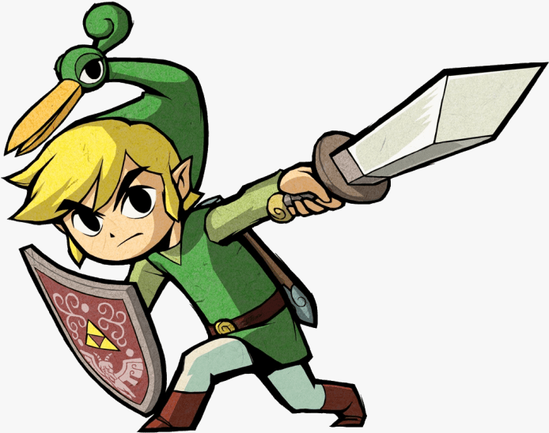
Links to Research
Students:

Slide 12
Links to Research
Students:
Become accountable for their own learning
Notes:
Education research is generally very supportive of SLPCs over the more traditional parent teacher conference. One of the most commonly agreed upon outcomes of SLPCs is that students become accountable for their own learning (Cleland, 1999; Cromwell, 2010; Hennick, 2016). Students become aware of what their strengths are, and what areas they need more work in. In practicing what they will tell their parents about their learning, they learn valuable communication skills (Cleland, 1999).
The preparation in advance of SLPCs is considerable, but worthwhile (Cleland, 1999; Hayden, 1998). Some teachers recommend starting preparation at the beginning of the school year. Establishing a portfolio that is organized and up to date becomes part of the regular classroom routine. Teachers report having good conversations during this process as students begin to understand that having areas that still need work is part of the learning process, which builds a growth mindset in learners (Hennick, 2016).
Parents report that they enjoy seeing their children take responsibility for their learning (Hayden, 1998). They get a chance to hear from their child and can focus on their child’s unique abilities. They have the opportunity to ask real questions and make plans for improvement (Hennick, 2016). However, some parents express a desire for private conversations with the teacher (Cromwell, 2010; Hennick, 2016). It is important that teachers make it clear that separate private meetings can be scheduled at separate times (Hennick, 2016).

Slide 13
Links to Research
Students:
Become accountable for their own learning
Become aware of what their strengths are, and what areas they need more work in

Slide 14
Links to Research
Students:
Become accountable for their own learning
Become aware of what their strengths are, and what areas they need more work in
Learn valuable communication skills

Slide 15
Links to Research
Students:
Become accountable for their own learning
Become aware of what their strengths are, and what areas they need more work in
Learn valuable communication skills
Learn that having areas that still need
work is part of the learning process,
Builds a growth mindset in learners

Slide 16
Links to Research
Parents:

Slide 17
Links to Research
Parents:
Enjoy seeing their children take responsibility for their learning

Slide 18
Links to Research
Parents:
Enjoy seeing their children take responsibility for their learning
Get a chance to hear from their child and can focus on their child’s unique abilities

Slide 19
Links to Research
Parents:
Enjoy seeing their children take responsibility for their learning
Get a chance to hear from their child and can focus on their child’s unique abilities
Have the opportunity to ask real questions
and make plans for improvement

Slide 20
Samples
Empowerent and Ownership for Students
Video! 2:15 - 4:40
https://www.youtube.com/watch?v=L_WBSInDc2E

Slide 21
Pros & Cons

Slide 22
Pros & Cons
Students are afforded more accountability in their learning and demonstration of their learning
Students get to work on and improve their communication skills
Higher parent attendance - they get to see their child taking responsibility
It is valuable for parents to see how proud their children are and to hear them talk about their process
A parent’s failure to attend a student-led conference is very disappointing for a child
Some students have a tough time being articulate in front of an audience, even if the audience is just their parents.
Some parents want a private one-on-one conversation with their child's teacher, receiving his or her viewpoint.
Parents can be unsure of what the expectations of them are

Slide 23
Bias

Slide 24
Bias

Slide 25
Bias
Students’ level of comfort with formal discourse
Notes:
SLPCs may favour those individuals who are more comfortable demonstrating their understanding in a public space over those who may not be (due to issues with self-confidence, anxiety, interpersonal skills, etc.). Perhaps this event can be approached and tailored on a case-by-case basis. The teacher could hold one-on-one meetings with students beforehand to discuss their feelings about the event. Teachers can assess whether alternative arrangements need to be made. It could be just a matter of preparing them for the occasion, frontloading the student with expectations for the event as well as with expectations for the student. Bottom line: be aware of your student’s level of comfortability and work to mitigate sensitivities beforehand.

Slide 26
Bias
Students’ level of comfort with formal discourse
Time restrictions
Notes:
Time restrictions could create bias. Some students are quick to explain/demonstrate their skills and understandings whereas others may need more time to divulge that information. Teacher can alleviate this bias by ensuring students have enough time to rehearse their stations multiple times beforehand.

Slide 27
Bias
Students’ level of comfort with formal discourse
Time restrictions
Language barriers
Notes:
Language barriers could create bias. Students and their families from countries where english is not used as a primary language may have a more difficult time accessing this event

Slide 28
Bias
Students’ level of comfort with formal discourse
Time restrictions
Language barriers
Accessibility concerns
Notes:
Accessibility can create bias if the student or parent is disabled (visually impaired, wheelchair bound, hearing impaired, etc.). This can be mitigated by ensuring the space works for all people (i.e., leaving enough space between tables so that a person in a wheelchair can easily pass through, speaking with the student well beforehand to ensure they are aware of who their audience is and can make all of the necessary modifications in their presentations, etc.)

Slide 29
Bias
Students’ level of comfort with formal discourse
Time restrictions
Language barriers
Accessibility concerns
Criminal record
Notes:
Past Criminal Records may prevent a parent from being on campus and interacting with other children in a school environment. Perhaps opening up the possibility of having an off campus meeting and a chance for the student to show their parent what they’ve been doing in class. This could be done with a kit to take home, or could be a pre-recorded video, or video conference.

Slide 30
Bias
Students’ level of comfort with formal discourse
Time restrictions
Language barriers
Accessibility concerns
Criminal record
Socioeconomic concerns
Notes:
Socioeconomic concerns - parents may be unable to make it as they are working multiple jobs. If a parent, guardian, relative, or friend can make it, then great! If not, ensure that the child’s guardian knows that doors of communication are always open. Depending on your level of comfort, you could have a skype interview and have the child share what they have prepared with their guardian, and if their guardian has any questions for you, you can answer then. Another option is for you to carve out some extra time in a day to have a private SLPC held in the classroom at a time that works for everyone involved.

Slide 31
Adaptations
Notes:
Here are some adaptations to help mitigate some of the disadvantages with SLCs

Slide 32
Adaptations

Slide 33
Adaptations
Flexibility for timing is CRUCIAL!

Slide 34
Adaptations
Flexibility for timing is CRUCIAL!
Options for morning, afternoon and evening sessions to make sure parents can attend or in case children are tired in the evenings, or for families with multiple kids at the school
Notes:
The Ministry of Education does allow schools to have 4 early closures in the year. Many schools offer two afternoons, back to back, in the Fall and again in the Spring, closing school at 1:00 to facilitate interviews so please mention that option.
If SLC are offered at different times this helps families with several children in the same school. Child care, under supervision of the Principal, if willing, can be offered. We used to ask for high school students, with child care certification, to volunteer. We usually made a donation to their school as a thank you. This allowed parents to focus on the child and know younger siblings were cared for in the child care area ( again supervised by Principal) . This ensured almost 100% turn out so child minding was appreciated by the families. Students also made invitations inviting families to the SLC- a personal touch helps.

Slide 35
Adaptations
Flexibility for timing is CRUCIAL!
Options for morning, afternoon and evening sessions to make sure parents can attend or in case children are tired in the evenings, or for families with multiple kids at the school
Allowable early school closures can be used

Slide 36
Adaptations
Flexibility for timing is CRUCIAL!
Options for morning, afternoon and evening sessions to make sure parents can attend or in case children are tired in the evenings, or for families with multiple kids at the school
Allowable early school closures can be used
Offer childcare for younger kids - supervised by principal, try find high school volunteers

Slide 37
Adaptations
Flexibility for timing is CRUCIAL!
Options for morning, afternoon and evening sessions to make sure parents can attend or in case children are tired in the evenings, or for families with multiple kids at the school
Allowable early school closures can be used
Offer childcare for younger kids - supervised by principal, try find high school volunteers
Have extra adults, or big buddies available to attend the conference with students whose parents do not attend

Slide 38
Adaptations
Flexibility for timing is CRUCIAL!
Options for morning, afternoon and evening sessions to make sure parents can attend or in case children are tired in the evenings, or for families with multiple kids at the school
Allowable early school closures can be used
Offer childcare for younger kids - supervised by principal, try find high school volunteers
Have extra adults, or big buddies available to attend the conference with students whose parents do not attend
For younger grades, sometimes a class performance after the conference can ensure a captive audience, student portfolios could be looked at beforehand in a casual way

Slide 39
Adaptations

Slide 40
Adaptations
Ensure children are well prepared, they should fully understand the centres and what specific activities will be taking place

Slide 41
Adaptations
Ensure children are well prepared, they should fully understand the centres and what specific activities will be taking place
Rehearse before hand, maybe with a buddy class

Slide 42
Adaptations
Ensure children are well prepared, they should fully understand the centres and what specific activities will be taking place
Rehearse before hand, maybe with a buddy class
To keep the night moving smoothly and not take too long:
Centres could be optional
Ask families to visit what you consider the most important centres first
Ask that each centre take no longer than 10-15 minute

Slide 43
Adaptations
Ensure children are well prepared, they should fully understand the centres and what specific activities will be taking place
Rehearse before hand, maybe with a buddy class
To keep the night moving smoothly and not take too long:
Centres could be optional
Ask families to visit what you consider the most important centres first
Ask that each centre take no longer than 10-15 minute
There should be clear instructions for both children and parents - a Conference Program or checklist can be given to children and parents ahead of time by email or hard copy
Ensure the instructions you post at centres and on the forms are clear

Slide 44
Samples

Slide 45
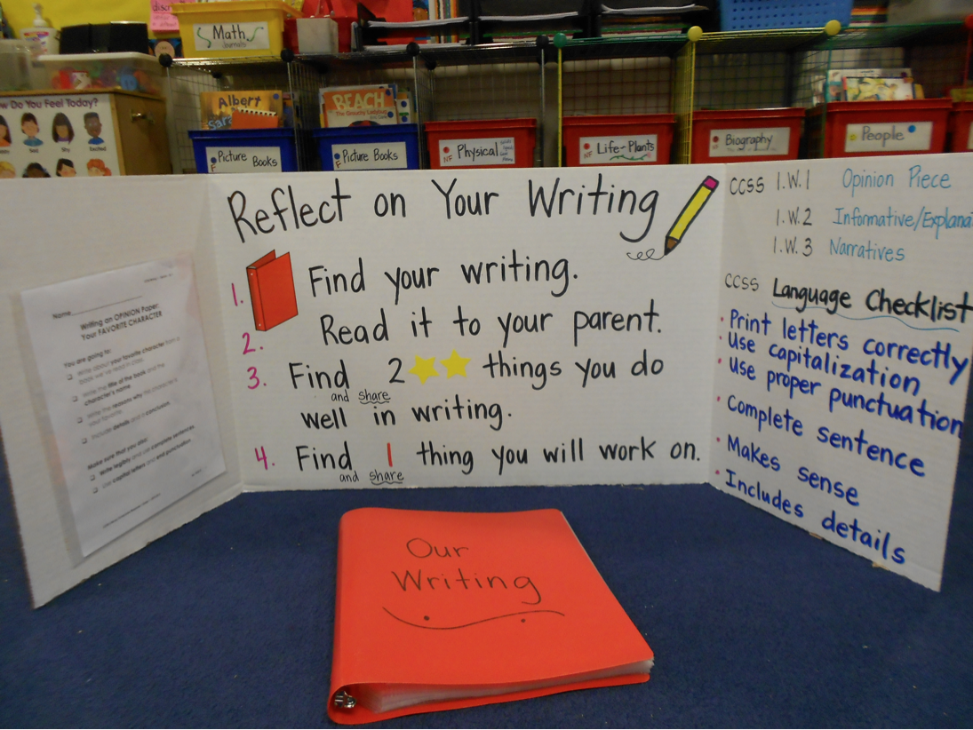
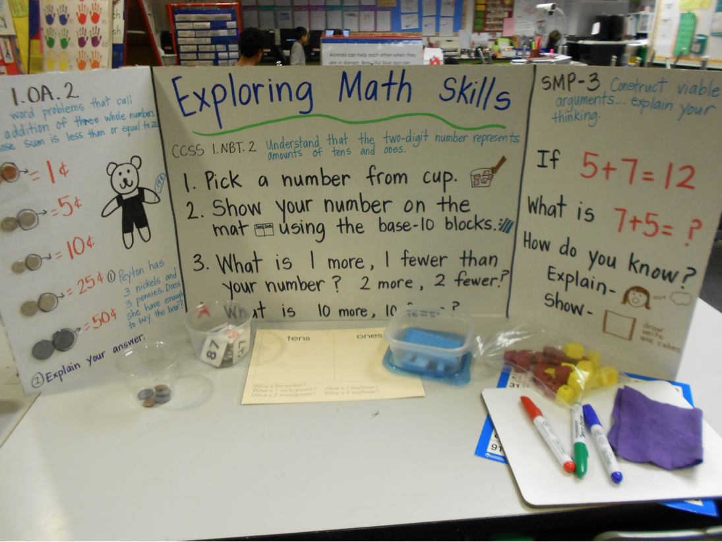
Samples

Slide 46
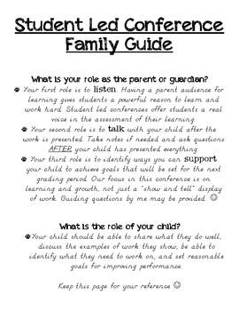
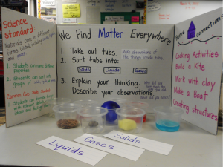
Samples

Slide 47
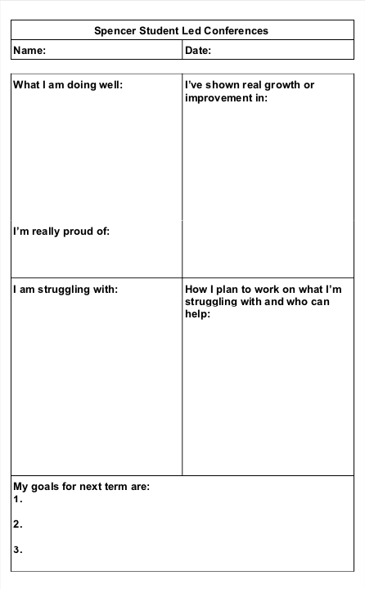
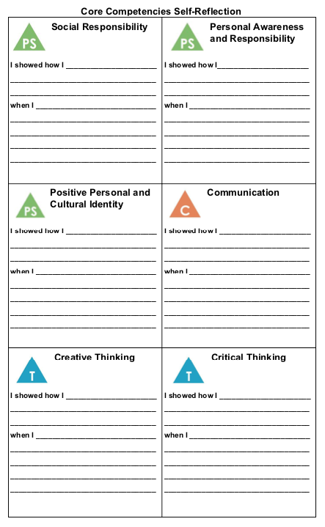
Samples

Slide 48
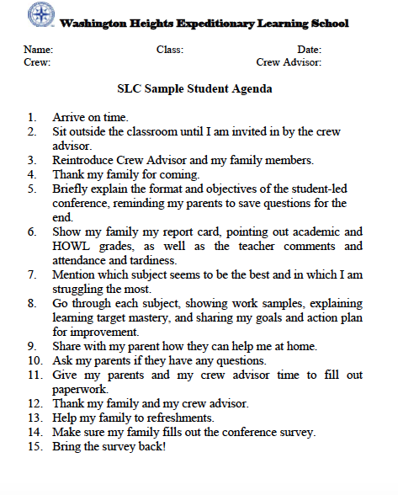
Extra aids for your Students
Giving students an agenda checklist helps the student to be organized.

Slide 49
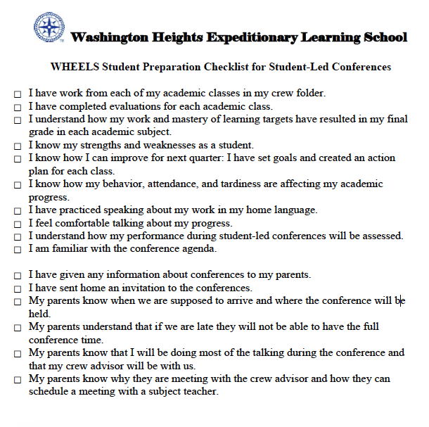
More aids
https://www.edutopia.org/blog/student-led-conferences-resources-ashley-cronin

Slide 50
Thoughts From Teachers

Slide 51
Thoughts From Teachers

Slide 52
Thoughts From Teachers
Darren Russell, Principal, Spencer Middle School
Darren came to Spencer last year and decided the school would shift to using SLPCs. There was some resistance from the teachers because change is hard

Slide 53
Thoughts From Teachers
Darren Russell, Principal, Spencer Middle School
Darren came to Spencer last year and decided the school would shift to using SLPCs. There was some resistance from the teachers because change is hard
Some teachers still wanted a chance for a private conversation

Slide 54
Thoughts From Teachers
Darren Russell, Principal, Spencer Middle School
Darren came to Spencer last year and decided the school would shift to using SLPCs. There was some resistance from the teachers because change is hard
Some teachers still wanted a chance for a private conversation
One solution for this is to have the teacher be a station the parents must visit

Slide 55
Thoughts From Teachers
Darren Russell, Principal, Spencer Middle School
Darren came to Spencer last year and decided the school would shift to using SLPCs. There was some resistance from the teachers because change is hard
Some teachers still wanted a chance for a private conversation
One solution for this is to have the teacher be a station the parents must visit
Any super important issues should be known about by parents ahead of time - NO SURPRISES for the parents in SLPCs or report cards

Slide 56
Thoughts From Teachers
Darren Russell, Principal, Spencer Middle School
Darren came to Spencer last year and decided the school would shift to using SLPCs. There was some resistance from the teachers because change is hard
Some teachers still wanted a chance for a private conversation
One solution for this is to have the teacher be a station the parents must visit
Any super important issues should be known about by parents ahead of time - NO SURPRISES for the parents in SLPCs or report cards
Tammy Orthner, Grade 6 Teacher, Spencer Middle School
“Parents want to know if you know their kid” - so her big focus was on getting this across

Slide 57
Thoughts From Teachers

Slide 58
Thoughts From Teachers
Paula Andrew, Grade 3 Teacher, Happy Valley Elementary
About two months prior to the first SLC, Paula gets her students to start assembling together a portfolio. This portfolio is a collection of various materials from all subjects, and this portfolio becomes the main tool for the children to reference during the SLCs

Slide 59
Thoughts From Teachers
Paula Andrew, Grade 3 Teacher, Happy Valley Elementary
About two months prior to the first SLC, Paula gets her students to start assembling together a portfolio. This portfolio is a collection of various materials from all subjects, and this portfolio becomes the main tool for the children to reference during the SLCs
Lisa Lockerbie, Nature Kindergarten, Sangster Elementary
Gives the opportunity for parents to speak to her during the SLC. If there are important, private issues that need to be discussed, Lisa will set up another meeting time. Usually there is regular conversation between Lisa and parents, so this isn’t often the case. SLCs are more a time for kids to show their family where they spend their days and what they do and learn

Slide 60
Closing

Slide 61
Closing
Take-away points:
SLPCs are beneficial for everyone
Reflect child’s learning
Can be done for all subjects
Offer student choice !
Disadvantages and biases can be mitigated
CELEBRATION of the child!

Slide 62
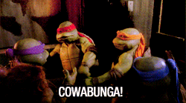

Slide 63
Activity
Student Led Conference Activity
Activity!
Activity!

Slide 64
Student Led Conference Activity
Prompts
What you are doing well?
What's one thing you are really proud of?
What you are really struggling with?
How do you plan to work on what you're struggling with? Who can help?
What have you shown growth or improvement in?
What are your three goals for next term?
In partners, choose one person to be the student “leading the conference.”
Talk about some things you’ve learned in this term, and if/how you’ll incorporate SLCs into your own classroom.

Slide 65
RUSSIAN AL ENDORSES THIS
METHOD OF ASSESSMENT

Slide 66
References
Cleland, J.V. (1999). We Can Charts: Building blocks for student-led conferences. The Reading Teacher, 52(6), p. 588-595. Retrieved from:
https://www-jstor-org.ezproxy.library.uvic.ca/stable/20202131?pq-origsite=summon&seq=1#metadata_info_tab_contents
Cromwell, S. (2010). Student-led conferences: A growing trend. Education World. Retrieved from: https://www.educationworld.com/a_admin/admin/admin112.shtml.
Gregory, K., Cameron, C., Davies, A. (2011). Conferencing and reporting. Connections Publishing: Bloomington, IN.
Hayden, L. (1998). Letting Students Lead Parent Conferences And Student Makes Three. Middle Matters, Fall. Retrieved from: http://lrt.ednet.ns.ca/PD/math8support_11/comm_box_files/05_parent_teacher_student_meetings_pink/04_related_articles/02_letting_students_lead_parent_conf.pdf.
Hennick, (2016). Kids take the lead: student-led conferences can boost turnout rates and give kids a chance to shine. Scholastic Teacher, 126(1), p. 41+. Retrieved from https://go-gale-com.ezproxy.library.uvic.ca/ps/i.do?p=CPI&u=uvictoria&id=GALE|A478975767&v=2.1&it=r&sid=summon
Picciottto, Linda, P. (2011) Student-Led Parent Conferences - (resource from Quigg)
Another good resource https://www.edutopia.org/blog/student-led-conferences-resources-ashley-cronin

